Slide 1
How to use the Reshelving Period to indicate an awaiting reshelving period to the end user
Yoel Kortick
Senior Librarian

Slide 2
Introduction
Example before the configuration
Configuring the Reshelving Period
Example after the configuration
Another example

Slide 3
Introduction

Slide 4
Introduction
Typically when an item is returned at the circulation desk it will immediately appear in Alma and Primo search results as “On Shelf”.
It is possible however to configure that a certain amount of time must pass before the item will appear “On Shelf”, and this is in order to allow time for the library to “process” the item (for example put it on a cart and bring it to the shelf and put it back in place).

Slide 5
Introduction
This configuration is done via the “Time to reshelve (hours)” parameters
This parameter indicates the period of time that the item is considered as available, but shows as being reshelved in Alma and Primo so patrons and librarians know not to search for it on the shelf.

Slide 6
Example before the configuration

Slide 7
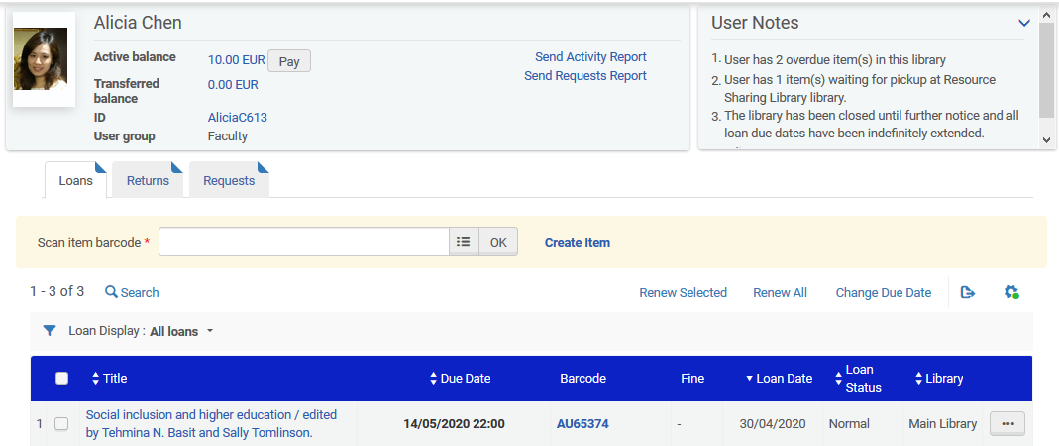
Example before the configuration
Title “Social inclusion and higher education” is on loan to Alicia Chen

Slide 8
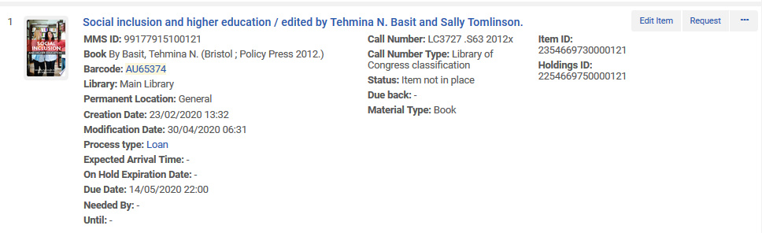
Example before the configuration
In Alma the item is “not in place”

Slide 9
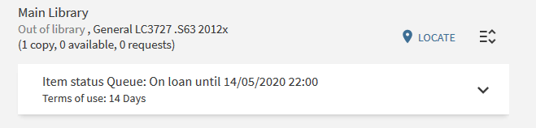
Example before the configuration
In Primo the item is “on loan until …”

Slide 10
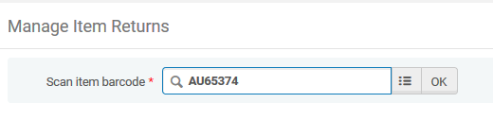
Example before the configuration
The item is returned

Slide 11
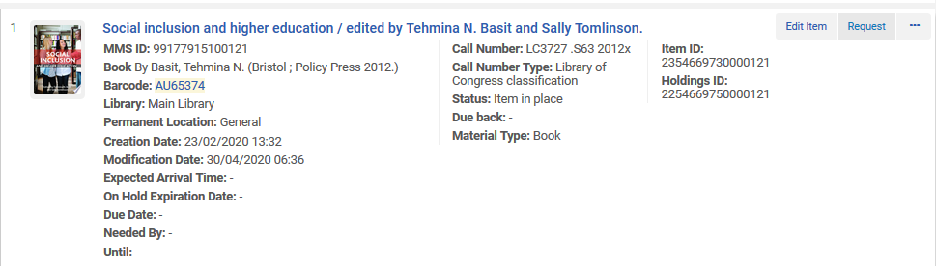
Example before the configuration
Now in Alma the item is immediately “In Place”

Slide 12
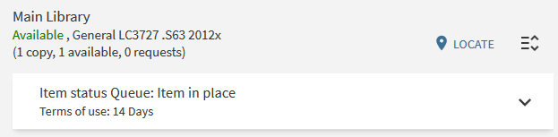
Example before the configuration
Now in Primo the item is immediately “In Place”

Slide 13
Configuring the Reshelving Period

Slide 14
Configuring the Reshelving Period
Now we want to indicate to the end user that the item is “awaiting reshelving” so that he or she will not think it can already be found in the stacks (on the shelf).
We want to set a period of time to indicate when it is expected to be reshelved.
We will do this by setting the “Time to reshelve”.
This can be set at the Library or Circulation Desk level.
The Circulation Desk takes precedence over the Library, thus the Library may have two Circulation Desks each with different reshelving times.
In the example here we will set the parameter on the library level.

Slide 15
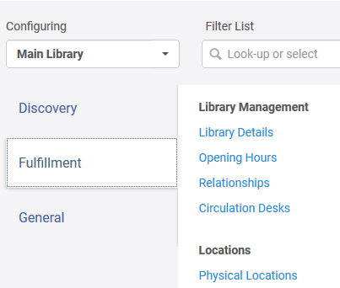
Configuring the Reshelving Period
The reshelving period is configured at Fulfillment > Library Management > Library Details
Here we could set it on the level of the circulation desk
Configure on the level of the library

Slide 16
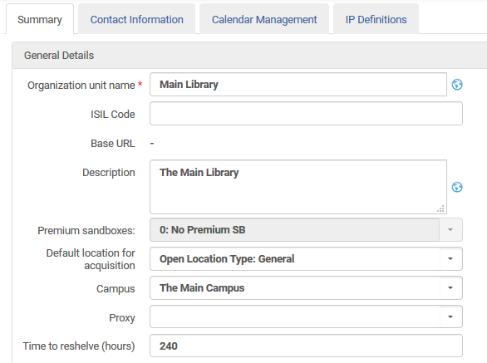
Configuring the Reshelving Period
Fill in the “Time to reshelve (hours)” as desired. 240 hours will be for example 10 days.

Slide 17
Example after the configuration

Slide 18
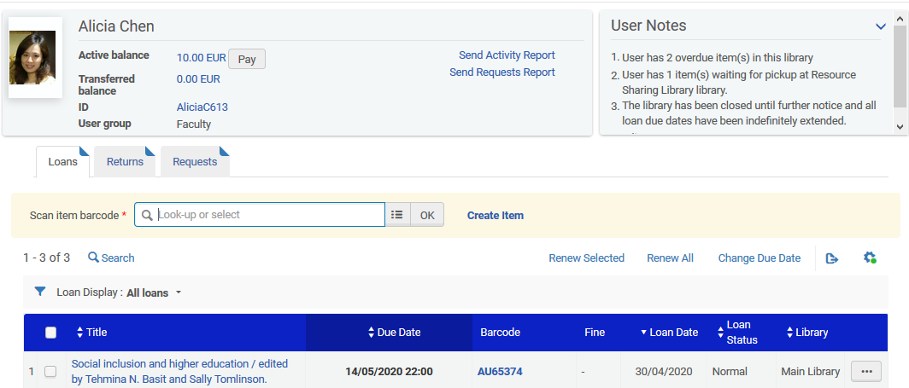
Example after the configuration
Again we loan “Social inclusion and higher education” to Alicia Chen

Slide 19
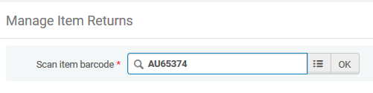
Example after the configuration
Again we return it, this time on May 30, 2020 at 06:55 AM

Slide 20
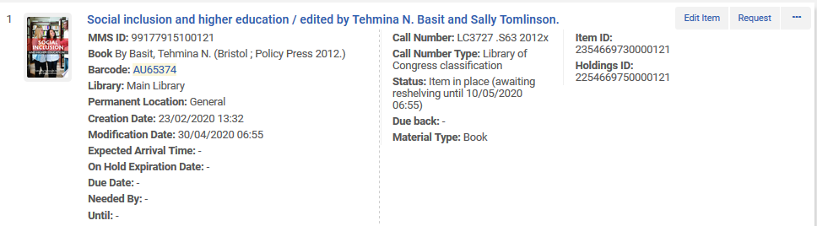
Example after the configuration
In Alma the item is “awaiting reshelving” until May 10 (today is April 30, so May 10 is in ten days, or 240 hours)

Slide 21
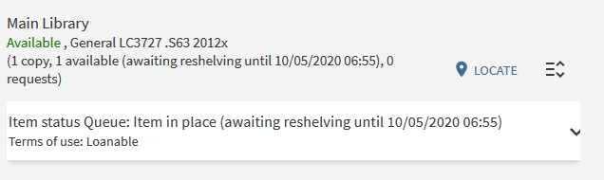
Example after the configuration
In Primo also the item is “awaiting reshelving” until May 10

Slide 22
Another example

Slide 23
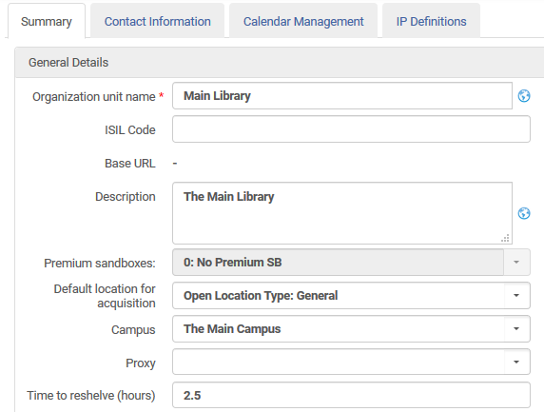
Another example
This time we will make the reshelving time 2.5 hours

Slide 24
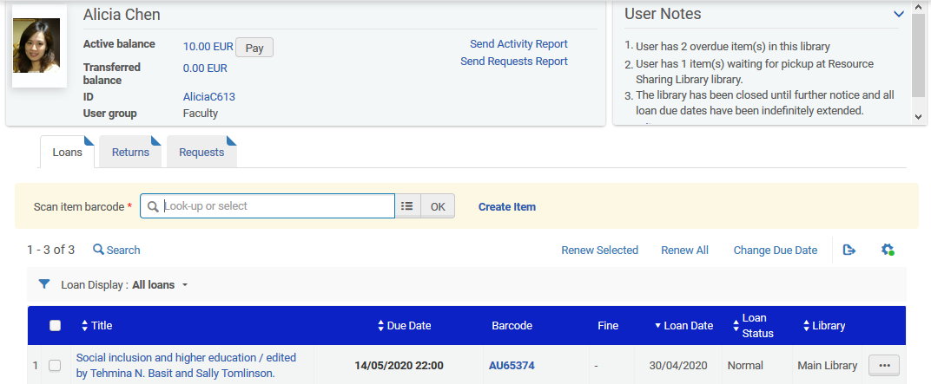
Another example
The title “Social inclusion and higher education” is again on loan

Slide 25
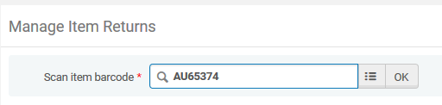
Another example
The item is returned, this time on May 30, 2020 at 07:08

Slide 26
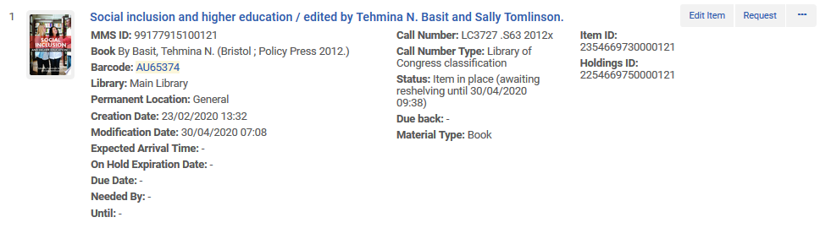
Another example
In Alma the item is “awaiting reshelving” until April 30 at 09:38 AM (which is 2.5 hours later than the return date of April 30 at 07:08 AM)

Slide 27
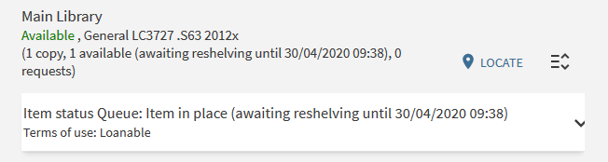
Another example
In Primo the item is also “awaiting reshelving” until April 30 at 09:38 AM

Slide 28
Thank you!
xxx@exlibrisgroup.com

